Slide 1
EARLY DETECTION OF PLAQUE IN CAROTID ARTERY

Slide 2
Table of Contents
I
Introduction
3
II
Problem Statement
4
III
U-Net Architecture
6
IV
Sample Input
9
V
Output
11
2

Slide 3
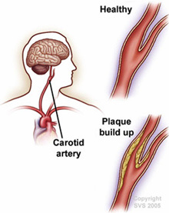
INTRODUCTION
The carotid arteries are major blood vessels in the neck that supply oxygenated blood to the brain, neck, and face.
Internal Carotid Artery (ICA): Supplies blood to the brain.
Found on both sides of the neck, with one artery on the left and one on the right.
Blockages or narrowing can lead to serious conditions like stroke or clotting of blood in the brain.
Significance:
Early diagnosis and management are crucial to prevent complications.
2

Slide 4
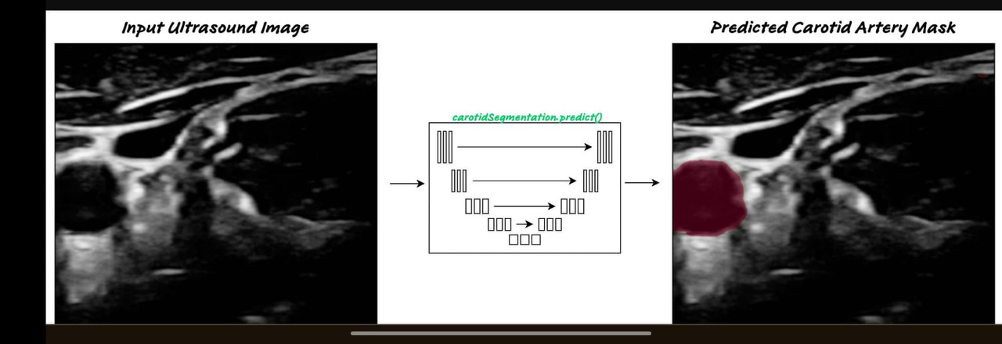
PROBLEM STATEMENT
1
2
Develop a robust algorithm for automatic segmentation and plaque analysis in carotid artery using Deep Learning techniques for quantification of risk measurement .
Visualization of 3D model of carotid artery to aid the clinician in the assessment of plaque vulnerability.
2

Slide 5
MOTIVATION
Prevention of Stroke and Cardiovascular Events
Early detection of carotid artery plaque can prevent life-threatening conditions like strokes, reducing
mortality and morbidity.
Addressing Gaps in Existing Diagnostics
Current methods may lack precision or accessibility; this project seeks to provide more accurate and
widely applicable solutions.

Slide 6
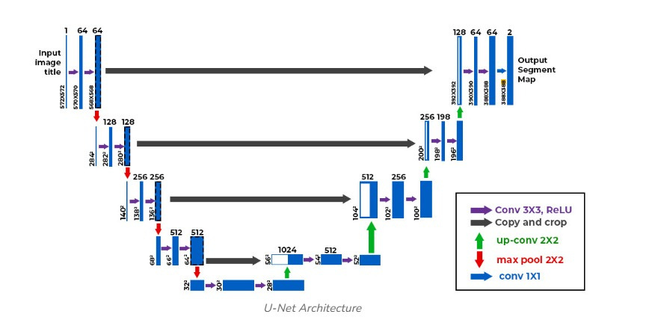
U-NET ARCHITECTURE
U-Net is a deep learning model primarily used for image segmentation tasks. It is particularly well-suited for biomedical image analysis due to its ability to capture both high-resolution spatial information and contextual features.
2

Slide 7
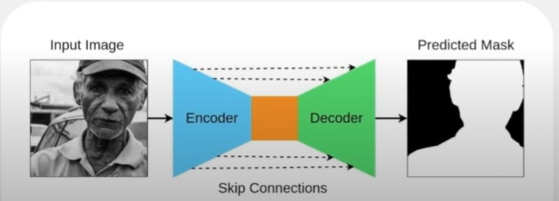
STEPS IN U-NET ARCHITECTURE
INPUT IMAGE:
Provides a raw input image i.e ultrasound image.
ENCODER:
Convolutional layers
ReLU activations
Max-polling operations
BOTTLENECK(Bridge):
Connect the encoder and decoder with layers at
the smallest resolution.
DECODER:
Upsampling layers
Restore the spatial resolution of the feature maps.
OUTPUT SEGMENTATION MAP:
Apply final 1x1 convolutional layers.
2

Slide 8
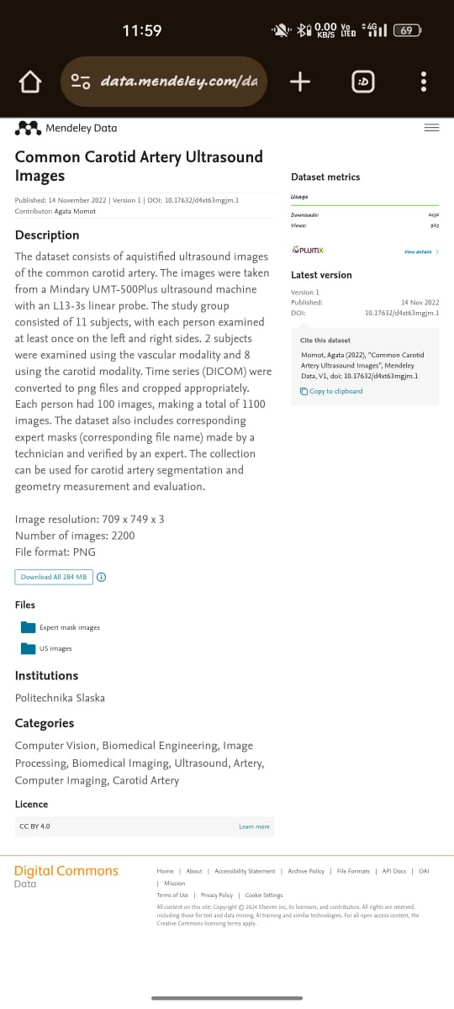
DATASETS
Dataset/
├── train/
│ ├── US_images/
│ │ ├── image1.png
│ │ ├── image2.png
│ │ ├── ...
│ ├── masks/
│ │ ├── image1_mask.png
│ │ ├── image2_mask.png
│ │ ├── ...
2

Slide 9
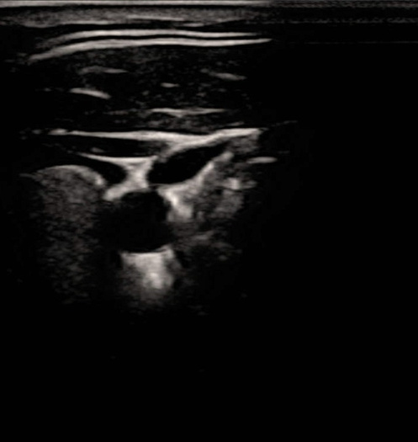


SAMPLE INPUT
Encoder
Decoder
256×256×64
128×128×128
64×64×128
32×32×256
16×16×512
Final Layer
16×16×512
32×32×256
64×64×128
128×128×128
256×256×64
Input Image (256x256x1) --> [Encoder] --> [Bottleneck] --> [Decoder] --> Output Segmentation Map (256x256x1)
256×256×1 output where each pixel value represents the tumor class (e.g., 0 = background, 1 = tumor).
2

Slide 10

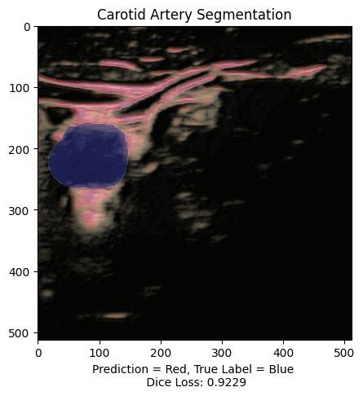
SUPER IMPOSITION PRINCIPLE
ORIGINAL
MASK
SUPER IMPOSED IMAGE
Dice Coefficient=2⋅∣P∩G∣/ |P|+|G|
DICE LOSS = 1-Dice Coefficient

Slide 11
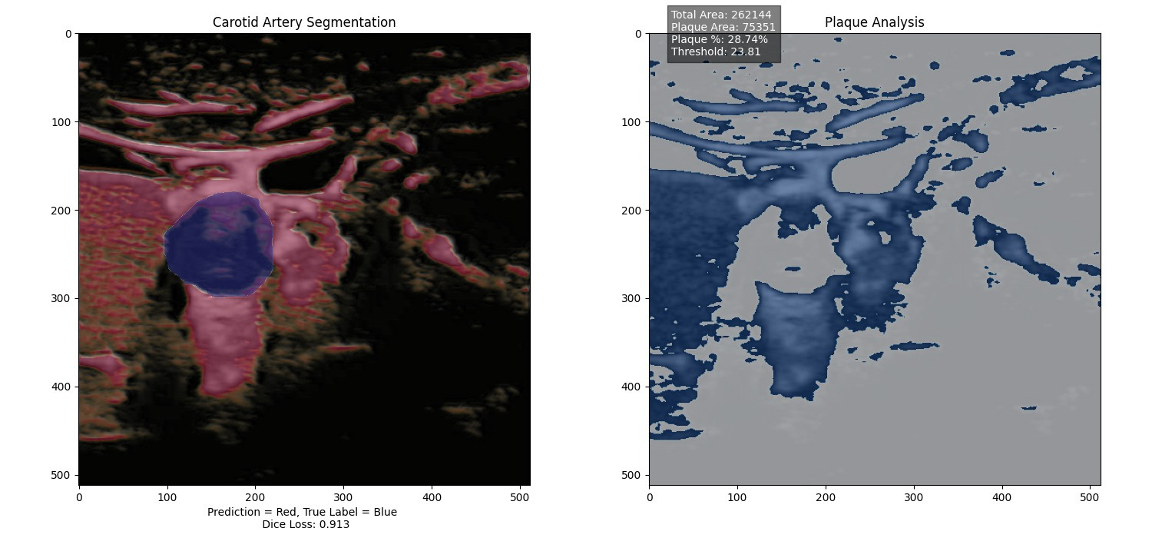
OUTPUT
Analyzes plaque regions in the artery and visualizes the results.
valid_pixels = extracted_background[~np.isnan(extracted_background)]
mean_intensity = np.mean(valid_pixels)
std_dev_intensity = np.std(valid_pixels)
threshold = mean_intensity + 0.001 * std_dev_intensity
2

Slide 12
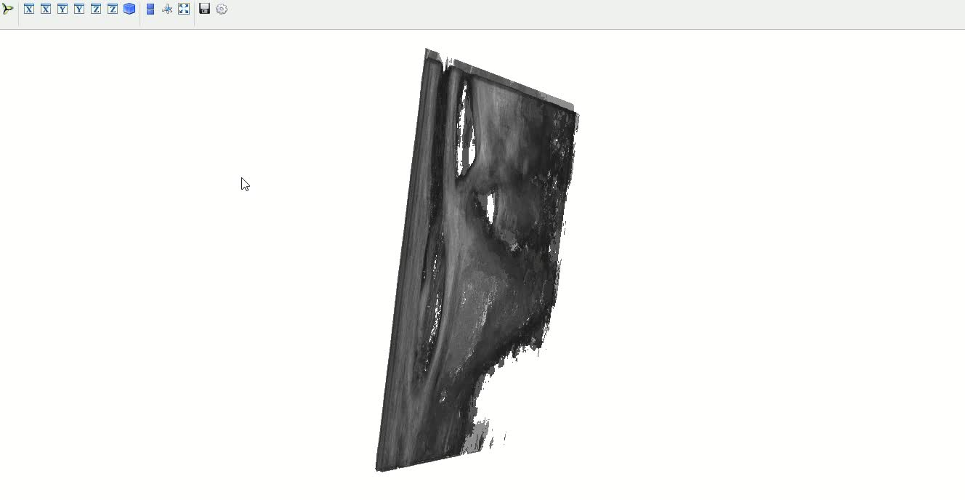
3D-VISUALIZATION
2

Slide 13
NOVELTY
Integration of Advanced Imaging Techniques
Utilizing high-resolution ultrasound for precise plaque characterization.
Application of Artificial Intelligence (AI)
Employing deep learning models (e.g., U-Net, CNNs) for automated plaque detection
and segmentation.
Early Diagnosis for Preventive Care
Facilitating early interventions to prevent strokes and other severe cardiovascular events.

Slide 14
APPLICATIONS
Clinical Settings
Hospitals and clinics for routine cardiovascular screening of at-risk individuals.
Specialized cardiac care units for detailed plaque assessment and monitoring.
Preventive Health Programs
Community health initiatives focusing on early detection and prevention of strokes.
Corporate health programs to screen employees for cardiovascular risks.
Research and Development
Academic and clinical research centers for studying plaque characteristics and progression.
Pharmaceutical and medical device companies developing targeted treatments and technologies.

Slide 15
Thank you!

